Slide 1
DoIT
ITC209 Assessment Item 5 App Presentation
Shirish Maharjan
11598385

Slide 2
Introduction
My name is Shirish Maharjan and I’m from Kathmandu, Nepal.
I am pursuing a Bachelor’s in Information Technology (Specializing in Software Development).
I love Science and Technology therefore to be involved in the field I have pursued this degree.
For short term I am looking for a Web Developer role. However, I would love to be involved in other fields in Software Development.
In long term I want to go back to my country and use technology to help in their day to day lives.
I have experience in Java, Java EE, JAX RS and other web APIs.

Slide 3
App Overview
DoIT is a to do list application.
A checklist helps us to stay focused and productive.
DoIT is a simple to do list application allowing users to add, edit and delete tasks and set a due date for the task.
The due date is a reminder for the user to stay focused on tasks.
Anyone looking to stay productive can use this app.
In this current day and age where everyone is busy, a to do list app comes in handy to stay productive.

Slide 4
Intended Functionality (More Details in Next Slide)
Add a Task to the database.
Add a Due Date and Time for a task and set a notification an hour before the due time.
Edit a Task and update the database.
Delete a Task/ Mark as done and delete the task from the database after 7 seconds.

Slide 5
Continued….
Users can add a task to the application which they need to do.
Added task is saved in the database for users to view later.
Edit a task when required allowing users to make changes to the tasks entered.
What’ the point of a checklist if one cannot mark it as done.
The satisfaction of completing a task is realized when the checkbox next to the task is checked and the task is deleted from the database.

Slide 6
Continued….
Do it also allows user to set a due date and time.
This allows the application to send a reminder.
A reminder is sent an hour before the task is due.
Reminders remind users to stay focused and productive.

Slide 7
Platform Used
Android Platform chosen for the development.
Android is the most popular platform used today.
Google Play Store has the most number of applications.

Slide 8
Tools Used
Android Studio used as IDE.
Android SDK API 18 (JellyBean 4.3) was used to develop the application.
Wdullaer Library was used for adding Date and Time Picker.

Slide 9

Device Requirements
OS Version: Android 4.3(Google APIs) API 18
AVD used while testing:
Nexus 5 with API 18, Android 4.3(Google APIs)

Slide 10
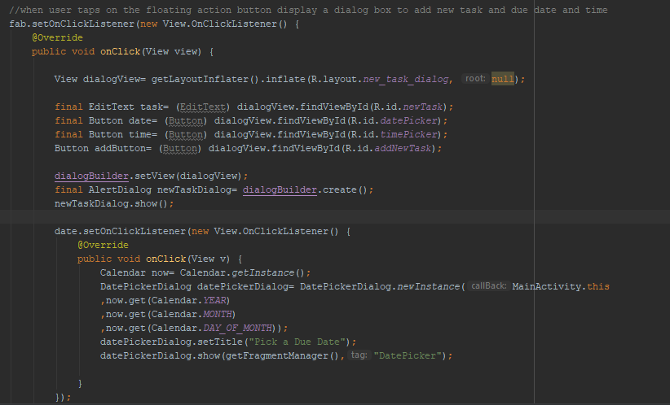
Techniques and Challenges
Interesting technique 1
Using different layout and inflating them inside a particular section.
Using a different layout for a dialog box as shown in the screenshot.

Slide 11
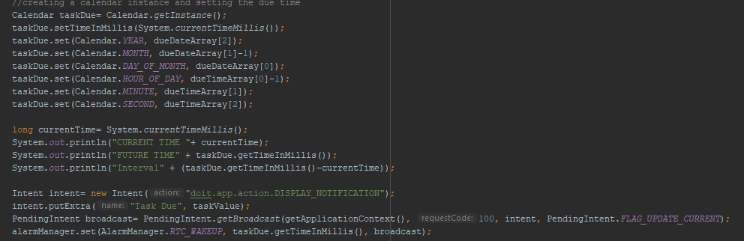
Techniques and Challenges continued…
Interesting technique 2
Using Calendar to set a certain time in a day and passing it to different methods.
Due Date and Time is set through Calendar to create a notification.

Slide 12

Techniques and Challenges continued..
Interesting technique 3
Toast Messages
Toast Messages are a brilliant and easy method to give feedback to the user.

Slide 13
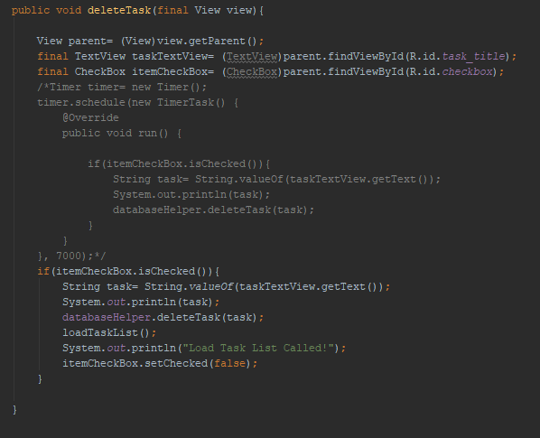
What couldn’t be done?
The task when checked to be deleted after 7 seconds.
Was done however created some bugs which didn’t update the ListView being displayed.
Task is deleted immediately after checkbox is checked.
Commented out code in the screenshot was used for the 7 second delay.

Slide 14
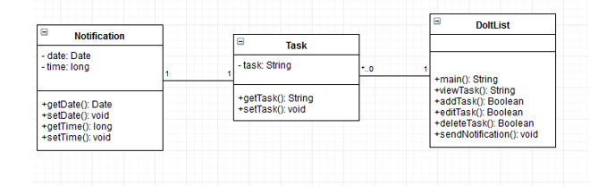
App Architecture
Class Diagram

Slide 15
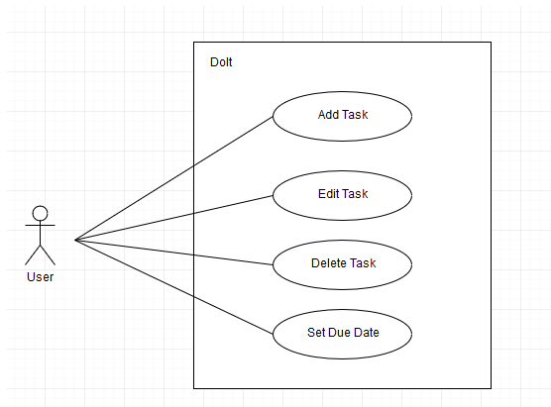
App Architecture continued..
Use Case Diagram

Slide 16
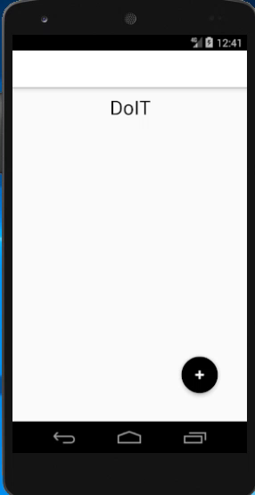
Demonstration
Firstly adding a task to the to do list and setting a due date and time.
When due time approaches a notification is sent notifying the user that a task is due.
Task is deleted by checking the check box.
Task is edited by simply tapping on the text.
Even when application is reopened, entered tasks exists because they are stored in a internal database.

